Slide 1

Agentic Syndicate

Slide 2
The first quantitative trading firm for polymarket 🇸🇳
🇸🇳 🇸🇳 🇸🇳
Senegal-gal-gal illegal scheiß egal-gal-gal Wuppertal

Slide 3
Idea
Imagine a world where venture capital remains not a privilege to nerdy VC founders, no, it´s democratized! How do we do that? We enable those to launch, that previously didn´t stand a chance: beautiful women on social media, that don’t yet realize their potential to make bank on OnlyFans
Update: two hours later, 3 bears later, and a little more sober, we realize this idea might be a bit controversial in wokeistan (aka San Francisco). Okayyy. So we do we do? Well, we love money, so we just change the industry.
And what industry is more exciting than …

Slide 4

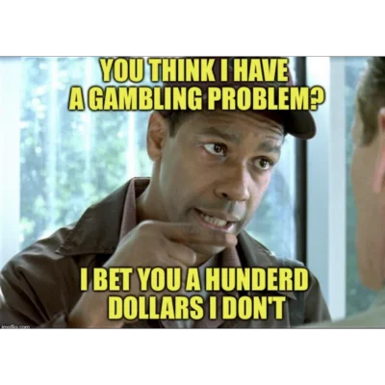
BETTING

Slide 5
Idea #2
Polymarket is the next big thing
People love betting and love making money off betting
How do we exploit those people?
Let us introduce you to how polymarket works

Slide 6
How does polymarket work?
Polymarket works via markets
Polymarket is a decentralized prediction market where users bet on the outcome of real-world events by buying and selling shares in those outcomes. It operates on the Polygon blockchain using smart contracts to automate trades and settlements in a transparent, tamper-proof way. To participate, users deposit a stablecoin like USDC into their self-custodial wallet, purchase shares that fluctuate in price based on market demand, and can sell them at any time before the event concludes. When the event is resolved, shares for the correct outcome are redeemed for $1 each, while incorrect shares are worth nothing.
Markets on Polymarket are created by a dedicated markets team, not by users directly. Users can suggest new market ideas, but the team selects which markets to list based on several factors. While users cannot create their own markets, anyone can participate by buying and selling shares once a market is created and made public.

Slide 7
Now how do we bank on this?
Every person has one brain
Every brain can think about one thing
Which is not a lot…
An agent swarm can think about many things at once.
And that’s more than what a person can do.
So how do we bank on this?

Slide 8

How we actually bank on the fact that humans only have one brain
Okay, imagine a human with one brain competing against an ARMY of agents, each with one brain. If we have n agents, and 1 human, that means we have n times more agent brains than human brains. We consider the thinking capabilities the same. Hence, a swarm of agents can think about n times better than one human (except for Sam, he´s a genius).
The solution: RELEASE THE SWARM

Slide 9

THE SWARM PRESENTED BY GAUTAM
We are a quantitative trading firm that uses agent swarm that uses as much information as possible on polymarket bets to make MONEYYYYYY.
We are the first quantitative trading firm for Polymarket

Slide 10
Market Opportunity
Money bet on Polymarket: $3.3 billion USD
On a 5M USD fund, we would make 2.5M USD profit (assuming a winning probability of 75%)
  After 10 years: 288M USD!!!!!
  And remember that this is very conservative: we are assuming each dollar is only bet on ONCE a year, but theoretically we could bet infinite amount of times, so we could make probably a billion dollars in less than 5 years
This is one of the most profitable funds ever in financial history

Slide 11
Two things: backend and frontend

Slide 12
Backend
Look at how Jane street does their trades, what decision processes are involved, where human decisions come into play, and literally COPY this 1 to 1, do not feel ashamed
Just copy what Jane Street does
Focus on this
Remember decisions
(Hyperspell), learn from them, and update ML
model and Agentic search
Collect data
(BrowserUse,
Perplexity)
Make decision
(ML, Replit)
create browser
agents
a lot of data
on specific bet
betting decision
Too complicated

Slide 13
Backend Tech Stack
Hyperspell
  Angents need to remember previous trades and learn from them
Replit
  We want our agents to reason before closing a trade
BrowserUse/Perplexity
  Need to retrieve information on web on which to base our trades

Slide 14
Frontend
We will use the same trading frontend that Jane Street uses

Slide 15
Name ideas we had when we were sober again:
Quantflow
Flexquant
Prior
Bayesian Street
Agentic Alpha
Agentic Syndicate/Entropy
Syndicate
Quagentic

